Slide 1
Introduction to Docker
27 October 2017 | Jakob Højgaard

Slide 2
Agenda
01
What is Docker
02
Why should I care
03
Docker 101
04
Compose
05
Orchestration – Mesos, DC/OS, Kubernetes

Slide 3

Jakob Højgaard
Software developers Swiss Army knife, farther of three, brewer, rookie surfer, Consultant at Readify

Slide 4
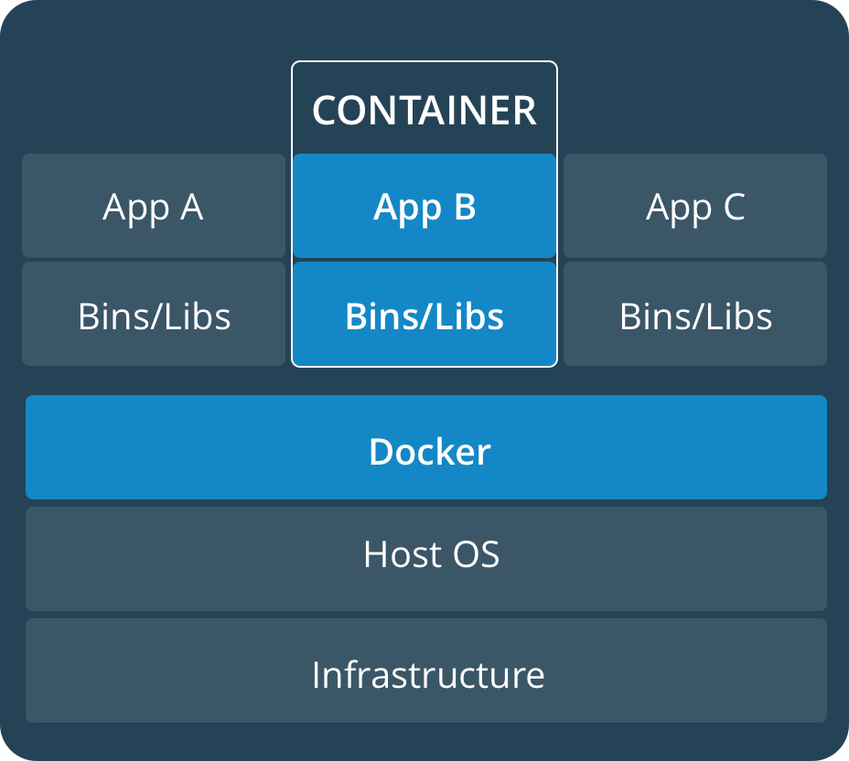
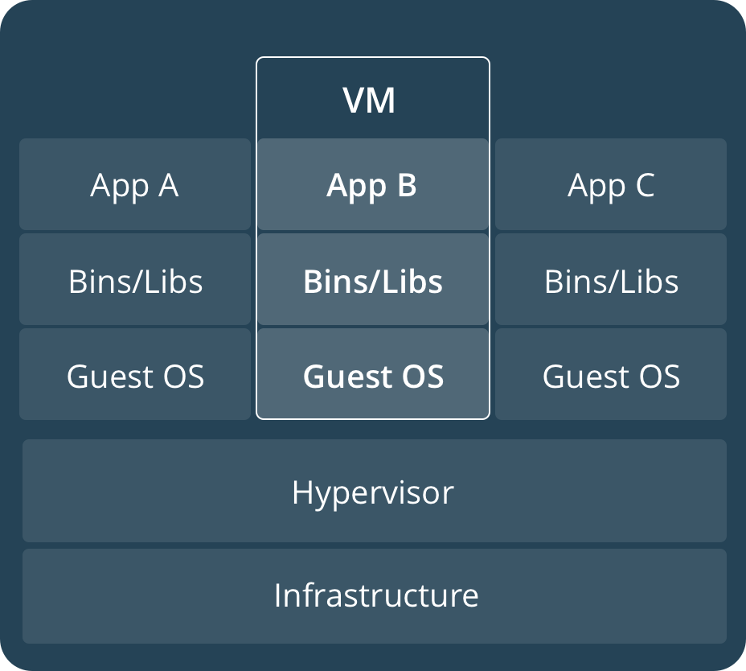
What is Docker
Virtualization of applications not OS

Slide 5
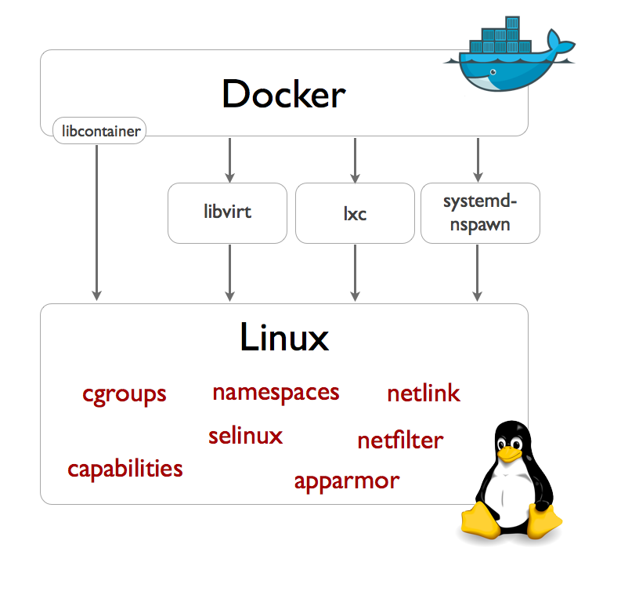
This is achieved by
cgroups - Manages recourse usage
namespaces – resource isolation
On Linux everything is (represented) as a file

Slide 6
Why should I care?
Lightweight virtualization
Better utilization of hardware
Immutable deployments
Test the actual container before shipping
Fast scale out/orchestration
With Swarm, Mesos or Kubernetes
One-off tasks
Fast setup of environment for specific test or task

Slide 7
Docker 101

Slide 8
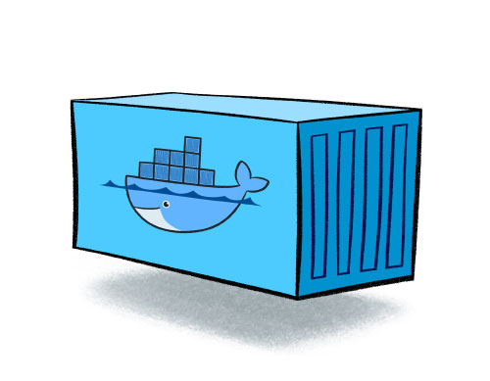
Containers and Images
Like objects and classes
Images are…
Layered – Union filesystem
From DOCKERFILE
Containers can be shipped
Multiple instances
Across a cluster of machines

Slide 9
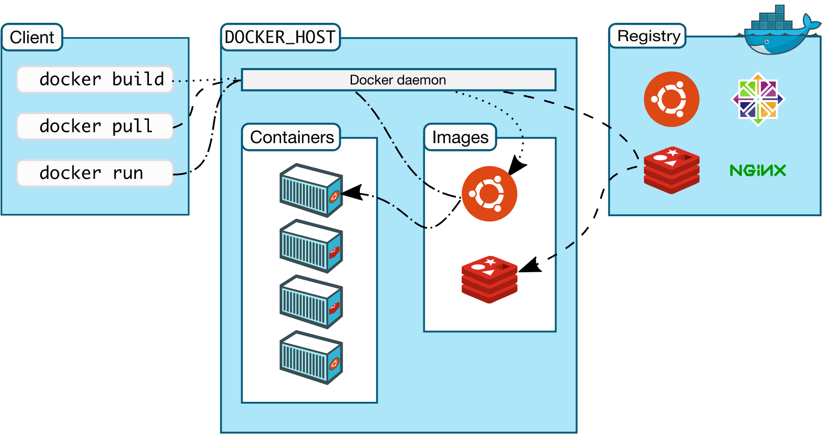
How it works

Slide 10
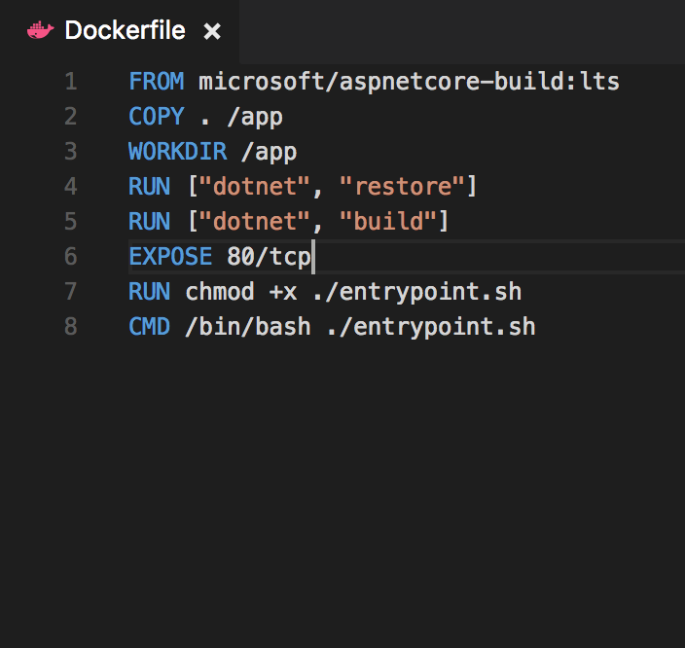
Building an image
Dockerfile
Specifies base image
Specifies a set of commands to run to build the app

Slide 11
Hello world Demo

Slide 12
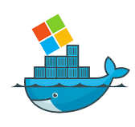
Docker on Windows
Same Docker
Images/containers are windows specific
Built on new native container tech in windows 2016

Slide 13
Developer dependencies
SQL server
redis
Seq
ElasticSearch
Oracle
One-off tools

Slide 14
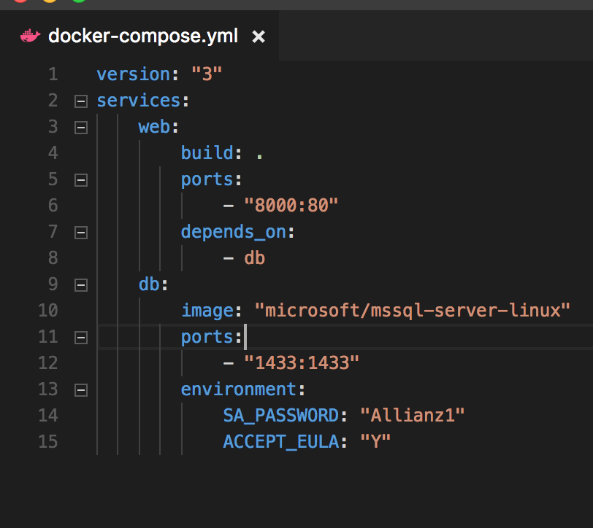
Composing apps
Docker compose
Defines relations/dependencies between containers
How to retrieve/build them
Network between them
Defines volumes

Slide 15
Hello compose - Demo
From: https://docs.docker.com/compose/aspnet-mssql-compose/

Slide 16
Orchestration
Kubernetes
Swarm
DC/OS
Solves the problem of managing a cluster

Slide 17
Get started
I did a workshop with my colleague Tod Thomson that you can go through
https://github.com/todthomson/intro-to-linux-dotnetcore-docker
A docker specific version
https://github.com/hgaard/intro-to-docker

